Slide 1
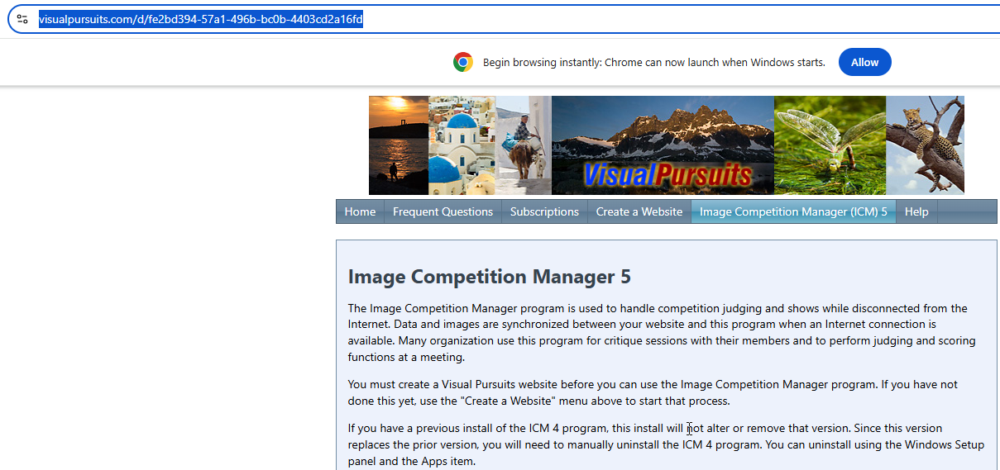
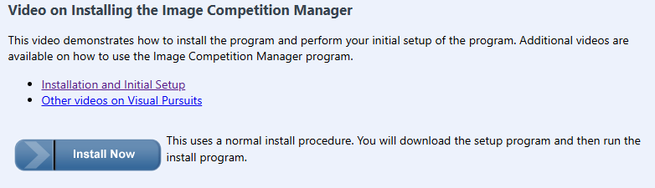
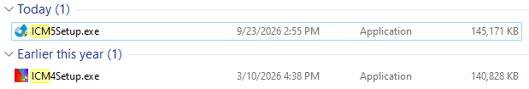
https://www.visualpursuits.com/d/fe2bd394-57a1-496b-bc0b-4403cd2a16fd

Slide 2
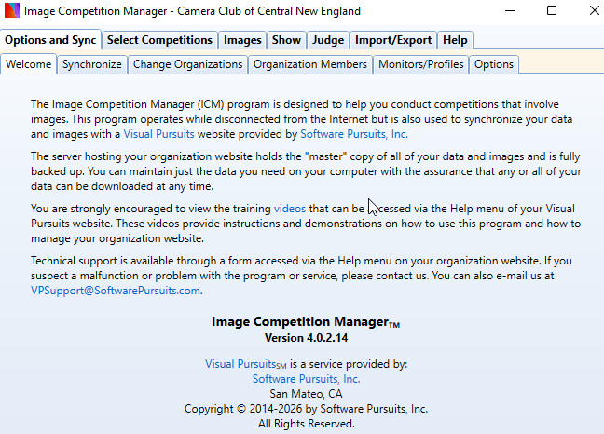
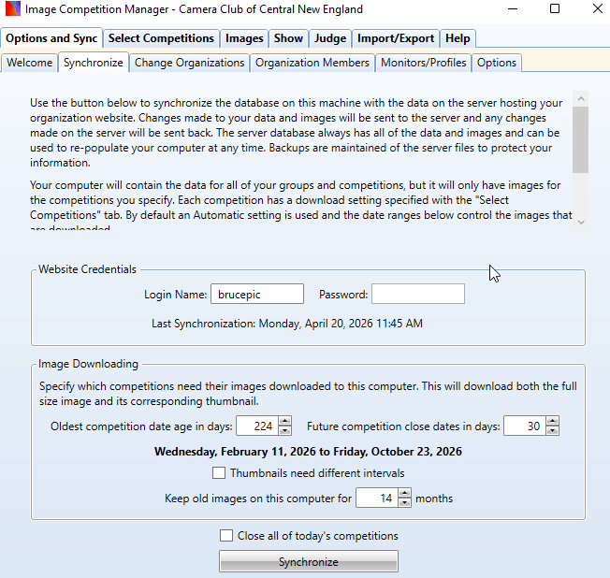
login name is brucepic
Password is ZnaEAe3t

